Slide 1
Deprecated Functions – Incorporate Scan
AVCDL-Implementation-6.1.2
Charles Wilson
Staff Product Cybersecurity Architect
version 4
2026-04-07
Notes:
Script:
I'm Charles Wilson, staff product cybersecurity architect at Torc Robotics.
This presentation will cover the Deprecated Functions – Incorporate Scan activity.

Slide 2
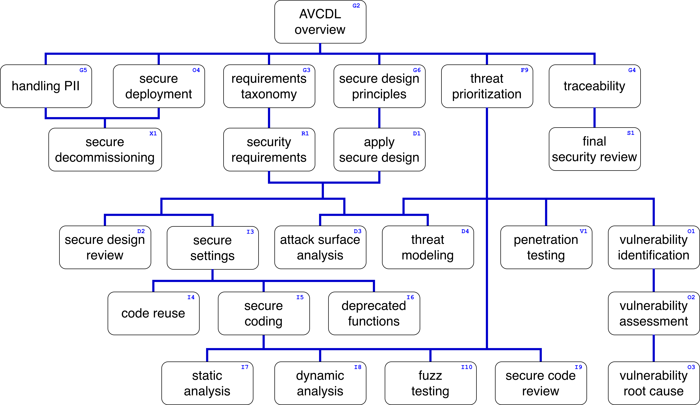
Training Path
Notes:
Script:
This diagram shows the overall AVCDL training path.
If you're taking this training, it's assumed that you've already completed the AVCDL Overview training,
and additionally, that you've completed the
Requirements Taxonomy
Security Requirements
Secure Design Principles
Apply Secure Design
Secure Settings
Deprecated Functions Overview
and
Deprecated Function - Identify Functions
trainings.
This training will cover Deprecated Function Scanning Incorporation.

Slide 3
Workflow
Notes:
Script:
Before getting into scan incorporation, let's briefly review where it fits, in the overall deprecated functions process.

Slide 4
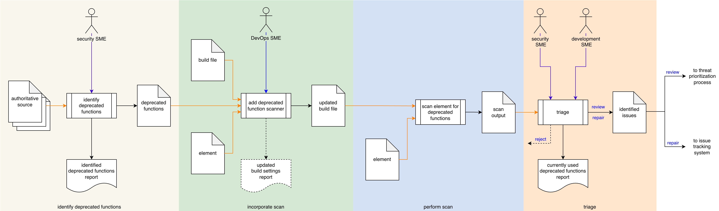
Process Workflow
Notes:
Script:
Here's the deprecated functions process which we previously covered in the Deprecated Functions Overview training.
[break]
Our focus for this training is going to be on the second activity, that of scanning incorporation.

Slide 5
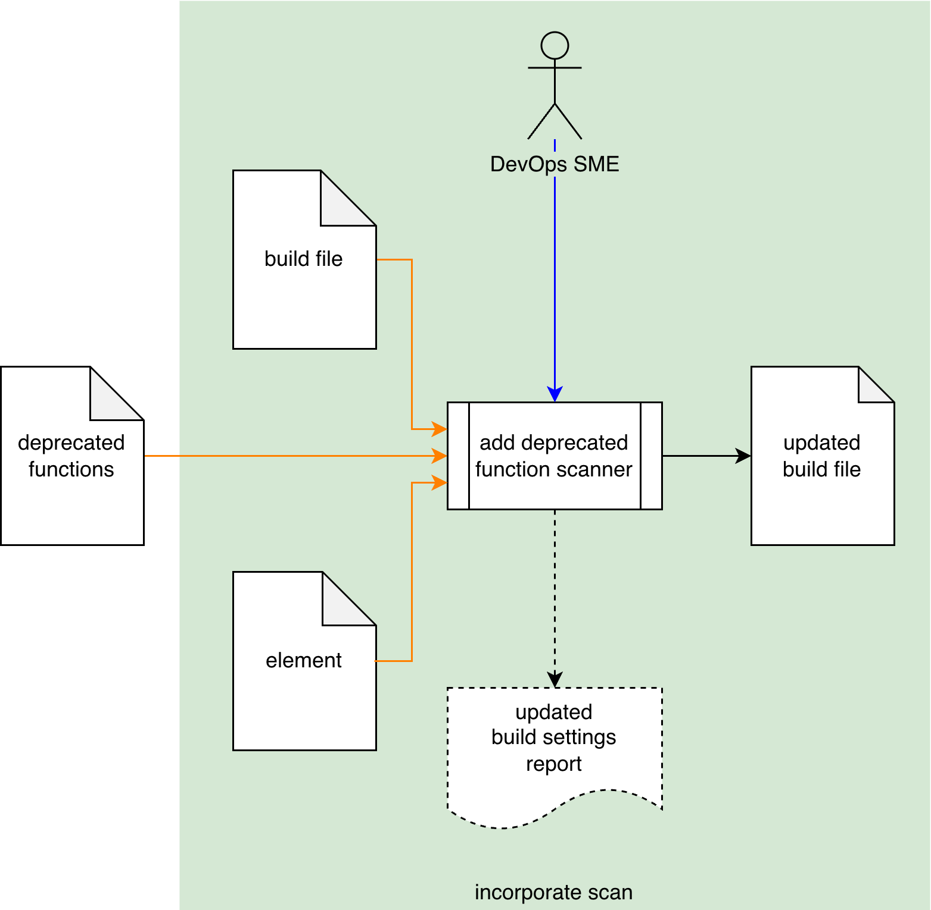
Process Workflow
Notes:
Script:
Here's the deprecated functions process which we previously covered in the Deprecated Functions Overview training.
[break]
Our focus for this training is going to be on the second activity, that of scanning incorporation.

Slide 6
Incorporate Scan Activity
Function information embodiment
Element scope
Build pipeline impact
Reporting
Notes:
Script:
In the incorporate scan activity,
[pause]
the DevOps SME takes
[pause]
the deprecated function list
[pause]
the element to be scanned
[pause]
and the build file
[pause]
and makes the changes necessary to the build file to enable scanning.
This results in
[pause]
an updated build file.
[pause]
If the build settings are changed, an updated build settings report is generated.
There are a few important points to consider when it comes to how the scan is actually incorporated for a particular element.
[pause]
First is the embodiment of the deprecated function information.
In the previous training on function identification, this information was compiled using the AVCDL deprecated functions catalog template.
It was noted that the information could be embodied as a database.
So, keep in mind that the source of the information the DevOps SME has to work with is not guaranteed to have a particular embodiment.
[pause]
Second, when updating the build file, you're doing so based on a particular element, not globally.
This avoids excessive scanning in areas which are not of interest.
[pause]
Third, as with all build process changes, it's important to consider the impact that the addition of the deprecated function scanning has on the build process itself.
Although, it's not anticipated that the scan is going to be time and resource intensive, at scale it may well be.
And so, it's important to pre-flight the scan to determine what impact it has and adjust the build timing accordingly.
[pause]
Treatment of the updated build settings report are covered in the Secure Settings process documented in the Secure Settings Document AVCDL secondary document, with additional detail provided in the Secure Settings Apply Options Procedure, AVCDL tertiary document, and their associated trainings.

Slide 7
Scanning Tool
Ingest deprecated function information
Avoid false positive scenarios
Output issues
Location
Description
Replacement
References
Notes:
Script:
Now, let's consider the scanning tool.
There's no single way that deprecated function scanning can be accomplished.
If you have a static analyzer or other tool capable of ingesting a list of deprecated functions and applying it against a specific element, that's great.
If you write a shell script to perform the same function, that works too.
It's all a matter of what the organization has made available to accomplish this task.
[pause]
The scanning tool should be able to:
[pause]
ingest the deprecated function information generated in the Identify Functions activity
[pause]
avoid foreseeable false positive scenarios such as names in string and comments, or those which are class member functions.
[pause]
and, of course, the tool needs to be able to output issues.
The output should include:
[pause]
the location of the deprecated function
[pause]
Additionally, if the tool is capable of doing so, it should provide
[pause]
a description with the reason for deprecation
[pause]
the recommended replacement
[pause]
and a reference to the source of the deprecation.

Slide 8
Example
Notes:
Script:
Now, let's have a look at some typical data that we'd be using to performing the scan in order to motivate the scan incorporation activity.
We'll be using the deprecated functions C++ on Linux workbook, based on the AVCDL template that was covered in the previous training on identifying functions.

Slide 9
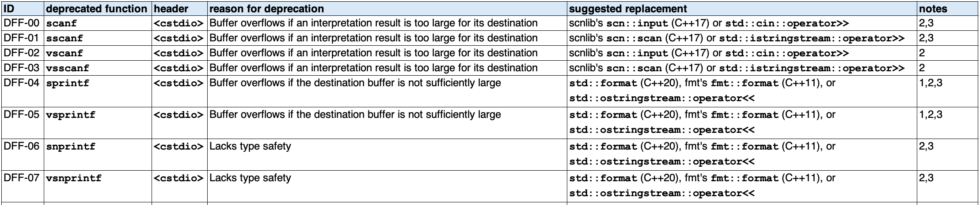
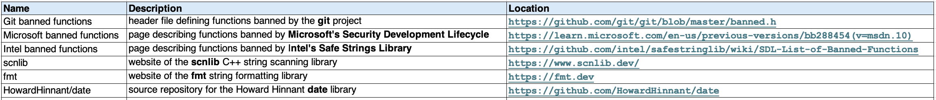
Deprecated Functions – Formatting
Notes:
Script:
As mentioned, we’ll be using the C++ on Linux deprecated functions workbook that was used in the identify functions training.
[pause]
Here’s the deprecated formatting functions sheets from the workbook.
[pause]
We have
• an ID
• the function itself
• the header it comes from
• the reason for deprecation
• a suggested replacement
and
• a notes column.
The notes column provides pointers back to
[pause]
the references which we see here, and those references include
• the name of the reference
• its description
and
• where it can be found.
When performing the scanning operation, minimally, we minimally require
[pause]
the deprecated function.
Now, we can see from this list that this family of functions.
Their names are virtually identical.
It's important if you're approaching this using manual scripting, that you take this into consideration.
Because the last thing you want is to see is,
[pause]
SCANF (DFF-00), show up as being a flagged function for all of
[pause]
the SCANF family of functions.
[pause]
Similarly, with SPRINTF
[pause]
and SNPRINTF.
If you don’t consider this sub-string effect, you're going to just have an unwieldy number of false positives.
Beyond identifying deprecated function, it would be nice to know why the function is deprecated, and what the suggested replacement is.
[pause]
Now one could get all sorts of fancy in terms of reporting the suggested replacement when you have a particular version of the language that you're considering.
In our example, we have replacements that require C++20, C++17, and C++11.
That implies much more sophisticated tooling in order to only report the applicable replacements.
[pause]
Additionally, having a reference to the particular sources is also useful.
As we can see here, the location information provide are URLs.
Now, if that's the case for all the ones that you have, then the tool can go to the notes, look up the particular entry and emit the location into the output.

Slide 10
Recap
Notes:
Script:
That covers deprecated function scan incorporation.
Let’s review some of the high points.

Slide 11
Summary
Select the scanner
Consider false positive scenarios
Apply the Secure Settings process if appropriate
Verify build
Notes:
Script:
That covers deprecated scan incorporation.
Let's review some of the high points.
Summary
First, select the scanner.
It may be an existing tool such as a static analyzer, or other off-the-shelf utility.
Alternately, you can create a custom script to perform this activity.
[pause]
Next, consider false positive scenarios.
This is especially important if you create a custom script.
When using a pre-existing scanner, make sure that it accurately identifies the deprecated functions uniquely.
[pause]
Next, apply the secure settings process if that's appropriate.
Remember that it’s this process which generates the updated build settings report.
[pause]
Finally, whenever the build is being augmented,
[pause]
you need to verify that the build will still work within the parameters of the CI/CD system.

Slide 12
Example Materials
<AVCDL>/distribution/reference_documents/working_material/deprecated functions/
Notes:
Script:
The materials that were used to cover this example are in the location shown here.
It's important to note that the workbook includes all the sheets covered in this training.

Slide 13
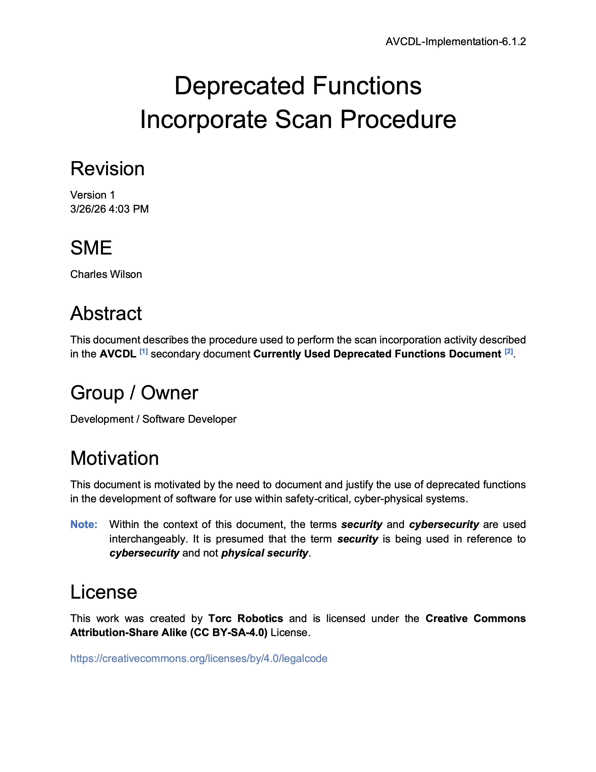
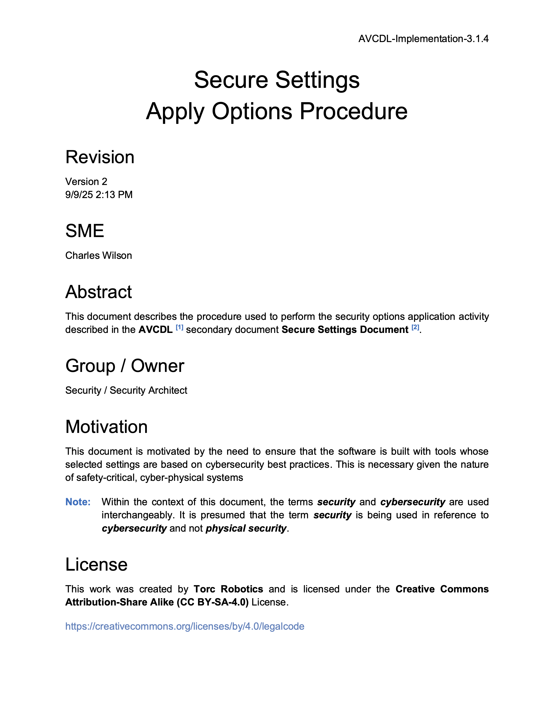
Further Reading
Notes:
Script:
For additional information and to get a more in-depth set of references,
[pause]
the Deprecated Functions Incorporate Scan Procedure tertiary document and
[pause]
the Secure Settings Apply Options Procedure tertiary document are both available in the AVCDL GitHub repository.

Slide 14
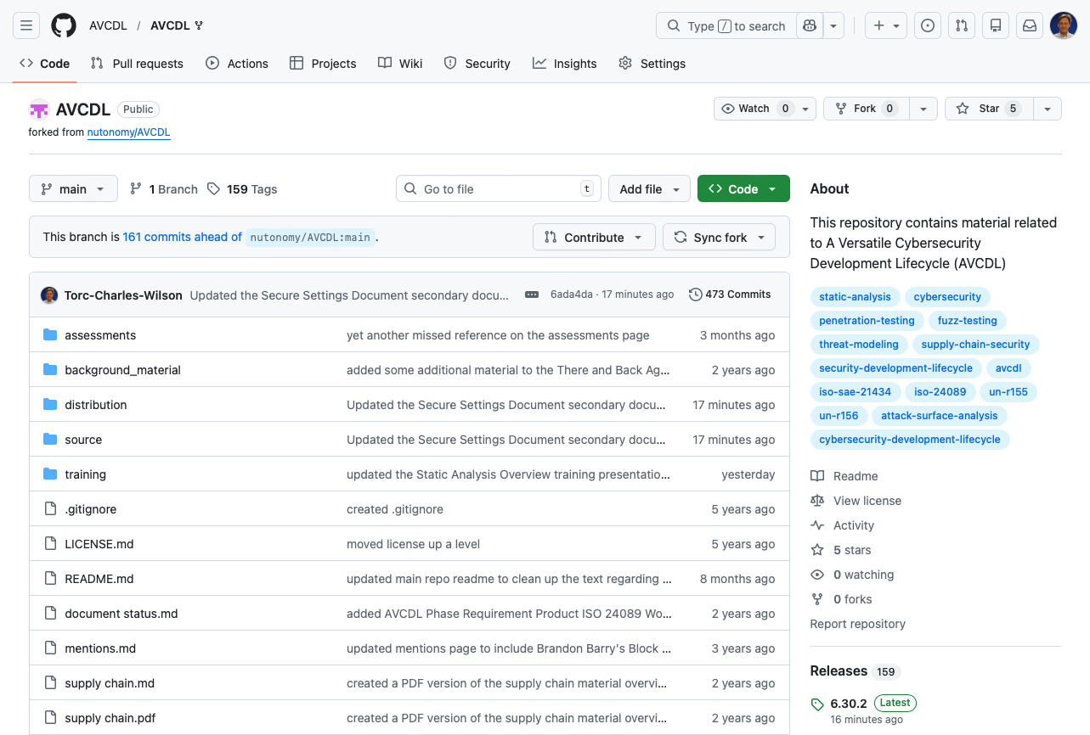
AVCDL on GitHub
https://github.com/AVCDL/AVCDL
Notes:
Script:
All AVCDL materials, both in source and distribution forms, are available on our GitHub site, as shown here.
Because of the size of the repository, it's recommended that you either clone the repository or download a ZIP archive of it, if you're not familiar with using git.
Instructions for downloading a ZIP archive are linked to on the repository’s front page.

Slide 15
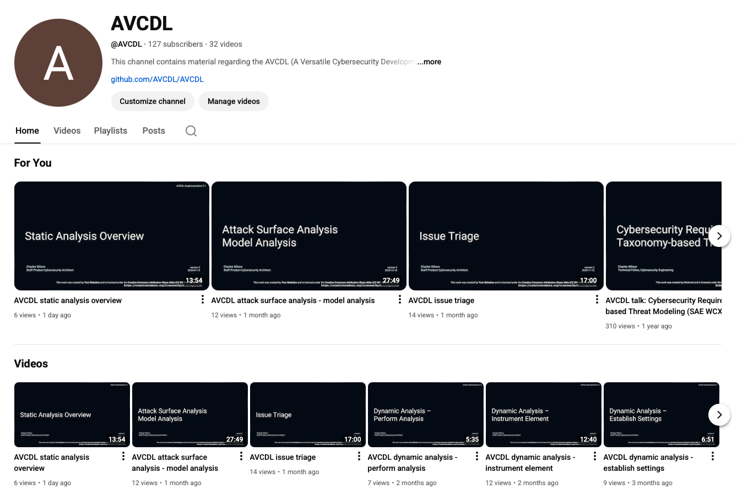
AVCDL on YouTube
https://youtube.com/@AVCDL
Notes:
Script:
Videos covering various aspects of the AVCDL are available on our YouTube channel, as shown here.
It's important to note that all AVCDL materials with the exception of the introductory blog posts are intended for product cybersecurity engineering practitioners.

Slide 16
Next Steps
Notes:
Script:
With this training complete, if you’ve completed the other trainings covering the Deprecated Functions process activities, you can proceed to the other trainings at this level, these include:
Code Reuse
and
Secure Coding

Slide 17
References
AVCDL primary document
Currently Used Deprecated Functions Document (AVCDL secondary document)
Secure Settings Document (AVCDL secondary document)
AVCDL deprecated functions catalog template (AVCDL template)
Deprecated Functions – Identify Functions Procedure (AVCDL tertiary document)
Secure Settings – Apply Options Procedure (AVCDL tertiary document)
Notes:
Script:
Here are the references to the source material used in the creation of this presentation.
They'll also be included in the video description.
Additionally, this presentation’s source material will be provided on the AVCDL GitHub repository.

